Slide 1
EASA Wildlife Strike Prevention
Update
Vasileios STEFANIOROS
Santiago HAYA-LEIVA
Martin BERNANDERSSON
TE.GEN.00409-001

Slide 2
Agenda
The Agency
Bird Strike data – European Central Repository
Current Activities
Future Plans

Slide 3
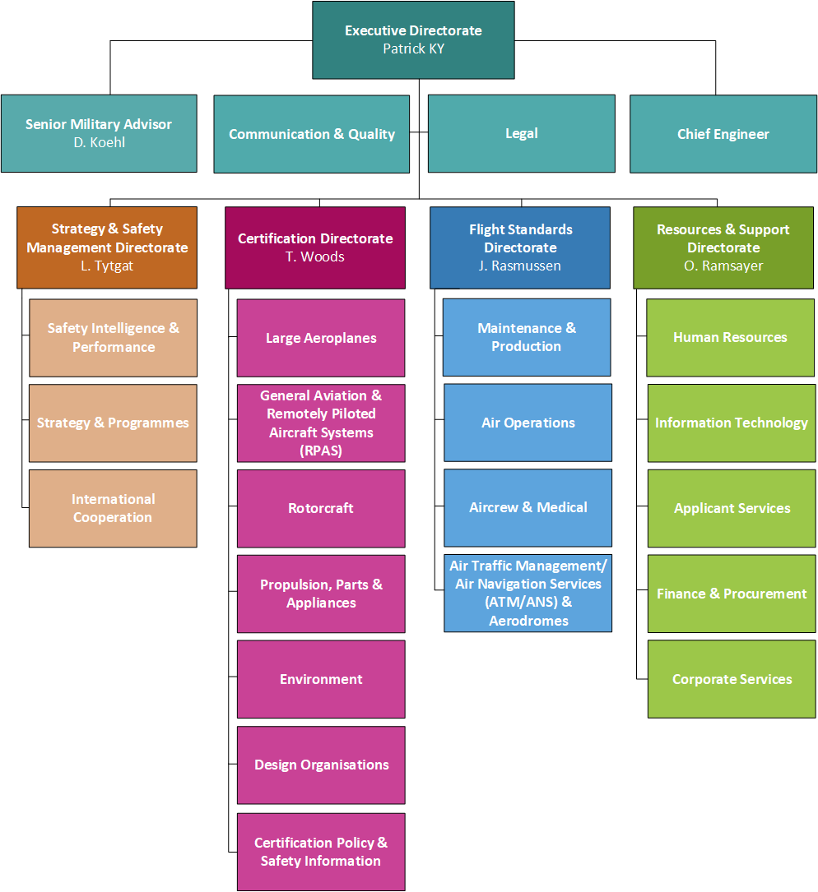
EASA – Organisation Structure

Slide 4
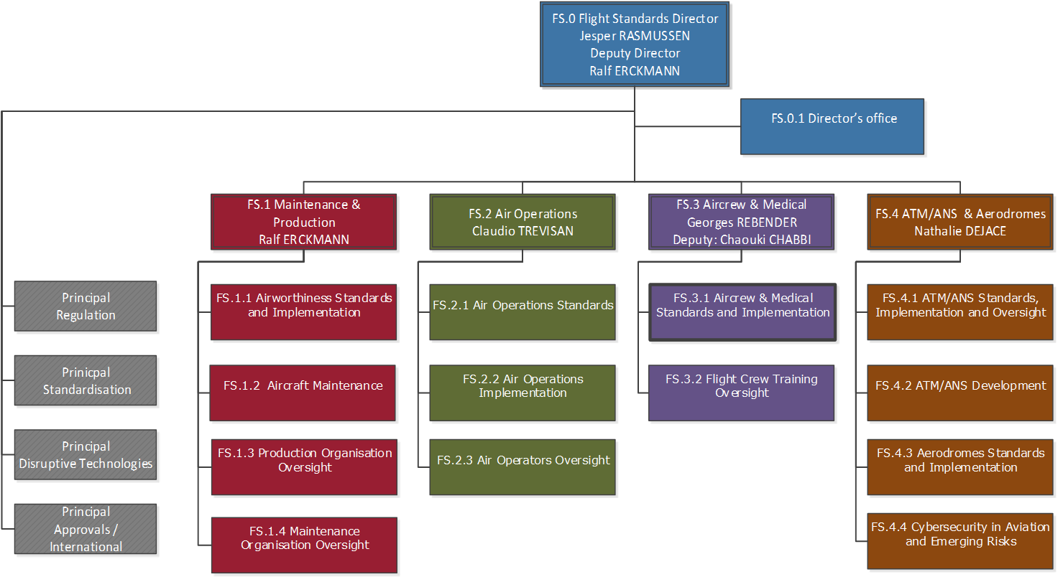
FS – Organisation Structure

Slide 5
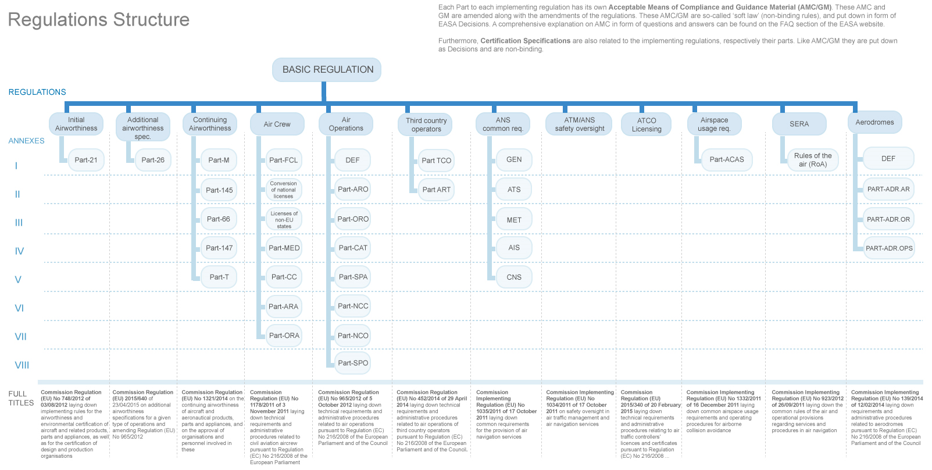
EASA Regulations

Slide 6
Data scope
Occurrences in the European Central Repository (ECR) fulfilling the following criteria:
  Related to Birds (actual, near-miss or bird control)
  Occurred in EASA-MS territory (aerodromes)
  Occurred between 2011 and 2017

Slide 7
Bird Strikes Data from the ECR
Continuous increase of bird strike reported occurrences since 2011
Yearly increase of 20%-40% since 2014
Similar increase for bird control-related reported occurrences (no actual birdstrikes but typically reporting ineffective bird control)

Slide 8
Correlation between reporting of bird strikes and bird control
There is a significant positive correlation between both, the of bird control and bird strikes reported occurrences
This relation may suggest an overall increase of the actual number of bird strikes and the insufficient bird control at the aerodrome
However, it is suspected that the overall improvement of reporting plays a major role in this trend

Slide 9
Data scope
Occurrences in the European Central Repository (ECR) fulfilling the following criteria:
  Occurrences not related to birds
  Occurred in EASA-MS territory (aerodromes)
  Occurred between 2011 and 2017

Slide 10
Occurrence Reporting in the ECR
The yearly increase and the overall trend of both, reported bird related occurrences and all the other occurrences is stable and similar over the last 6-year period
This suggests a strong correlation with the improvement of the reporting culture in Europe

Slide 11
Correlation between the overall reporting and bird related reporting
There is a strong positive statistical correlation between the increase of reported occurrences (other than bird strikes) and reported bird related occurrences
Expert judgement suggests strong causality behind this statistical correlation:
  Implementation of Regulation 376/2014 on occurrence reporting has caused an overall improvement of the reporting culture across Europe
  Regulation 376/2014 entered into force in November 2015

Slide 12
Preliminary Conclusions
The review of the ECR data related to bird strikes shows a continuous increase between 20% and 40% each year since 2014
However, this continuous increase is estimated to be due to the overall improvement of occurrence reporting across Europe during the implementation of Regulation 376/2014

Slide 13
ECR Birdstrike data – Birdstrikes per year

Slide 14
ECR Birdstrike data – Birdstrikes per month

Slide 15
ECR Birdstrike data – Birdstrikes per flight phase

Slide 16
ECR Birdstrike data – Birdstrikes per light conditions

Slide 17
ECR Birdstrike data – Birdstrikes per part of aircraft struck

Slide 18
ECR Birdstrike data – Effects on flights

Slide 19
Current activities
NPA 2017-16 – Engine bird ingestion
  Purpose
    To improve the ability of aeroplane turbine engines to cope with the ingestion of birds that can be reasonably expected to be experienced during the service life of the engine
  Why
    Safety Recommendation to the Agency by the NTSB following the US Airways accident
  What
    Changes to CS-E on engine bird ingestion demonstration provisions to include an additional requirement to continue operate following the ingestion of medium-sized bird into the engine core with a fan speed representative to the climb or approach condition, if no bird material is ingested into the engine during the test.

Slide 20
Future Plans
Wednesday 21/11/2018 09:30
See you all there

Slide 21
Thank you very much for your attention
aerodromes@easa.europa.eu

