Slide 1
Recent development of ICAO on wildlife strike hazard reduction
Yong Wang
Chief, Airport Operations and Infrastructure, ANB/ICAO

Slide 2
Overview
ICAO Safety Initiative
Outputs of the ICAO/ACI Wildlife Strike Hazard Reduction Symposium
Overview of ICAO Documentation
Ongoing Work at ICAO

Slide 3
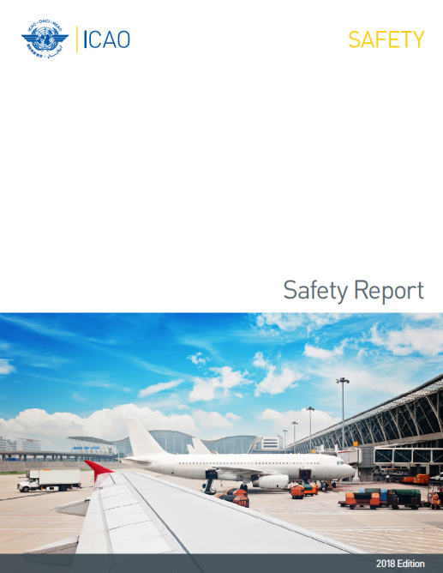
ICAO Safety Initiative
Presence of wildlife on and in the vicinity of aerodromes poses a serious threat to aircraft operational safety.
Wildlife strikes can cause accidents and serious incidents, costing the aviation industry billions in losses due to aircraft damage, flight delays and other operational impacts.
ICAO has been undertaking various initiatives to help States reduce wildlife strike hazard to aviation.
Wildlife Strike Hazard Reduction is an ICAO Safety initiative
Notes:
Wildlife hazard management is one of ICAO’s safety initiatives as reflected in the recent ICAO safety report, which is available at the ICAO website.
It is a safety threat; it can cause accidents and serious incidents; and it can cost aviation industry billions of dollars due to damage to aircraft, flight delays and other operational impacts.
ICAO has been undertaking various initiatives to tackle the challenge, including setting up international standards, providing guidance material and holding seminars/workshop and symposia…

Slide 4
ICAO/ACI Wildlife Strike Hazard Reduction Symposium (May 2017)
Increase the international awareness of the wildlife strike hazard to aircraft operational safety;
Build an international community to exchange ideas, experiences and cooperative efforts;
Advance new technologies; and
Formulate effective strategies in preventing and mitigating the risk of wildlife strikes to aircraft.
Notes:
Joint symposium with ACI in May 2017.
The objectives are…

Slide 5
International awareness
Comprehensive analysis of wildlife strike reports (2008-2015)
Use of the ICAO Bird Strike Information System (IBIS)
97 751 reports were received from 91 States on strikes occurring in 105 States and territories
2 501 reports had an indication of an effect on the flight:
  precautionary landings (49%); and
  aborted take offs (21%).
Notes:
To bring international awareness, ICAO did a comprehensive analysis based on the data from the IBIS.
Detailed analysis can be found on the ICAO website; here just mentions a few highlights…
The next slide will show you the results of the analysis performed for the Symposium. It shows an analysis of wildlife strikes on a global basis.
This latest analysis is based on over 97,751 (97 751) wildlife strike reports we received for the years of 2008 to 2015, and it is issued through the ICAO Electronic Bulletin EB 2017/25, which is available on the ICAO website.
This represent a significant increase from the 42 508 reports for the period of 2001 to 2007.
The first thing I’d like to mention is that still there are some States not reporting to ICAO. 91 States reported while wildlife strikes occurred in 105 States and territories from 2008 to 2015.
The analysis shows that 68 per cent of the wildlife strikes occurred during the day and 25 per cent occurred at night time.
Although wildlife strikes occurred throughout the year, the busiest period in term of period with the most number of reported wildlife strikes is from May through October. The months with the least reported number of wildlife strikes are January and February.
91 per cent of the strikes for which location data was furnished occurred on or near the aerodrome.
31 per cent of these occurred during the take-off phase while 59 per cent occurred during the approach and landing phase.
2 501 reports had a clear indication of an effect on the flight. 49 per cent of those strikes led to precautionary landings and 21 per cent resulted in aborted take offs.

Slide 6
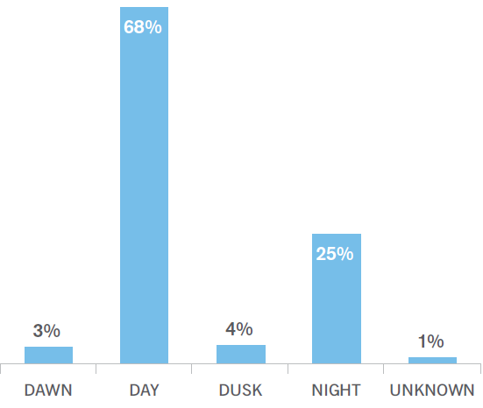
Wildlife Strike Occurrences by Light Conditions (2008–2015)

Slide 7
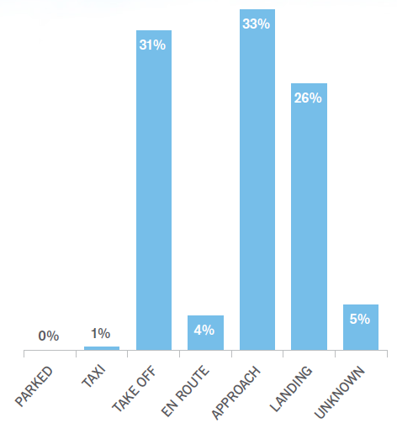
Wildlife Strike Occurrences by Flight Phase (2008-2015)

Slide 8
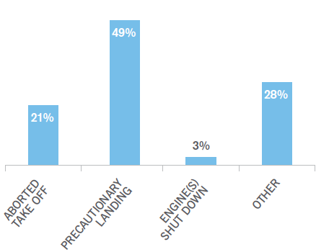
Wildlife Strike Effects on Flight
(2008-2015)

Slide 9
Outputs of the Wildlife Symposium -
Importance of cooperation
Involvement of multiple stakeholders;
Local Runway Safety Team should be consulted;
Focus on Airport Wildlife Committee;
Importance to work with local communities.
Notes:
Everybody has a responsibility
•Multiple-stakeholder cooperation is essential, involving regulators, airport operators, aircraft operators, air navigation service providers, pilots, manufacturers, local communities, as well as various wildlife strike committees at different levels;
•The airport’s Local Runway Safety Team should be consulted, and airport operators are encouraged to set up an Airport Wildlife Committee that concentrates on the issue;
•Cooperation and input on the wildlife hazard problem from all stakeholders of the industry could prove vital to narrow down solutions;
•Working with local communities, including land use planning is critically important. The airport operator must risk-assess the surrounding area and speak to external land users. They may be cooperative, but if they are not, the assistance of local, regional and national authorities is vital.

Slide 10
Outputs of the Wildlife Symposium -
Strengthening regulatory requirements
Need of appropriate legislation and regulation;
Importance of a national procedure for recording and reporting wildlife strikes;
An ongoing evaluation of the hazard by competent personnel.
Notes:
States need to have appropriate legislation and regulation to address the safety concerns, including those related to land use around an aerodrome;
Wildlife strike hazard to be assessed through:
a national procedure for recording and reporting wildlife strikes to aircraft;
the collection of information on the presence of wildlife constituting a potential hazard; and
an ongoing evaluation of the hazard by competent personnel.

Slide 11
Outputs of the Wildlife Symposium -
Use of new technology
More effective habitat management;
Possibility to inform go/ no-go advice from the tower and decisions by pilots;
Newer and better technologies to disperse birds away from aerodromes.
Notes:
Technology evolution to study wildlife patterns and movements could prove to be very helpful to facilitate more effective habitat management; and maybe to inform go/ no-go advice from the tower and decisions by pilots;
Newer and better technologies to disperse birds away from aerodromes could be promising.

Slide 12
Outputs of the Wildlife Symposium -
Effective wildlife hazard management
No one-size-fits-all solution for all states
  Wildlife control programme based on a wildlife survey of the airport and local area;
  Risk assessment based on the probability and severity of strikes by the types of birds and wildlife found at the airport;
  Control measures to be weighed and evaluated against the requirements;
Production of a Wildlife Hazard Management Programme
Training of personnel to manage an effective programme
Notes:
There cannot be a one-size-fits-all solution to wildlife hazard reduction for all states
• Wildlife around the world varies significantly; therefore, a tailored solution is pertinent for each member state;
• Wildlife control programme at each airport will be different, and must be based on a wildlife survey of the airport and local area;
• It is essential to apply SMS thinking - conduct a risk assessment based on the probability and severity of strikes by the types of birds and wildlife found at the airport. The risk matrix shows where efforts should be concentrated;
• Control measures must be weighed and evaluated against the requirements;
• That should lead to the production of a Wildlife Hazard Management Programme (and Plan) for the airport (for more guidance, see ICAO Airport Services Manual, Part 3 (Doc 9137) and the ACI Wildlife Hazard Handbook)
• Training of personnel to manage an effective wildlife control programme.

Slide 13
Overview of ICAO Documentation
Annexes 8, 11, 13, 14 Vol I, 15, 19
PANS-ATM (Doc 4444), PANS-Aerodromes (Doc 9981), PANS-AIM (Doc 10066)
Guidance material in ICAO manuals
  Airport Planning Manual (Doc 9184) - Part 2 Land Use and Environmental Control
  Airport Services Manual (Doc 9137) - Part 3 Wildlife Control and reduction
  Airport Services Manual (Doc 9137) - Part 8 Airport operational services
  Airport Services Manual (Doc 9137) - Part 9 Airport maintenance practices
  Manual on the ICAO Bird Strike information system (IBIS) (Doc 9332)

Slide 14
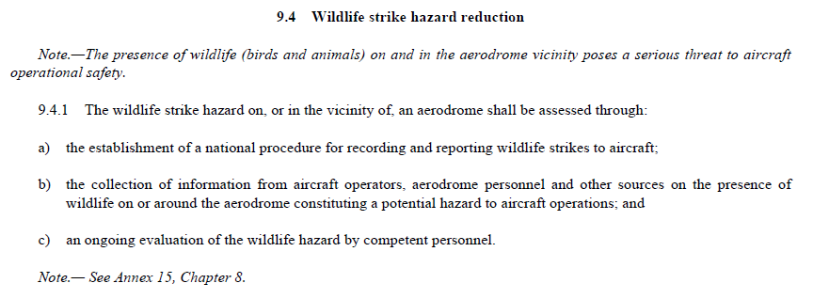
Annex 14, Volume I – Aerodromes
Notes:
I’d like to go through quickly the global standards in Annex 14, Volume I on wildlife hazard reduction.
First of all, the hazard shall be assessed through a national procedure for reporting the strikes, collecting information on the presence of wildlife that could be a potential hazards; and
Pay attention to c). Emphasize on the on going evaluation by competent personnel.

Slide 15
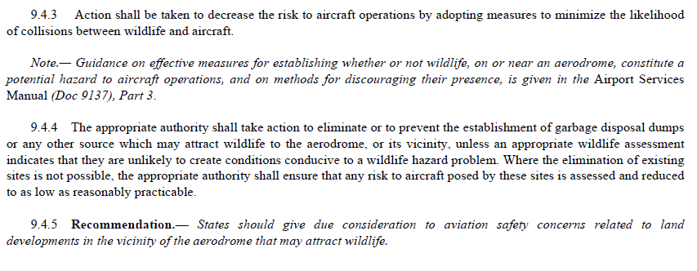
Annex 14, Volume I – Aerodromes
Notes:
9.4.3 Then take action to decrease the risk.
9.4.4 Specifically action shall be taken to eliminate the wildlife attractants.
9.4.5 Finally at the State level, strengthening the requirement on land developments in relation to safety concerns.

Slide 16
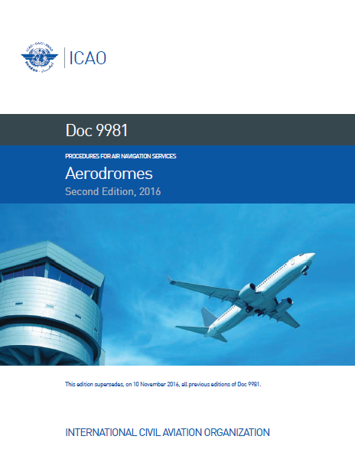
Ongoing work at ICAO
PANS-Aerodromes (Doc 9981)
Eight new chapters including a dedicated chapter on Wildlife hazard management
Consultation period for States completed (State letter AN 4/27-18/25)
Applicability date for PANS-Aerodromes with consequential amendments to Annex 14, Vol I and Annex 11: 5 November 2020
Notes:
PANS-Aerodromes (Doc 9981)
Eight new chapters including a dedicated chapter on Wildlife hazard management
Included in Part II of the PANS-Aerodromes which contains day-to-day operational matters
Consultation period for States completed (State letter AN 4/27-18/25 dated 16 July 2018)
The proposed amendments to the PANS-Aerodromes with consequential amendments to Annex 14, Volume I and Annex 11, are envisaged for applicability on 5 November 2020

Slide 17
PANS-Aerodromes (Doc 9981) objectives
To have a wildlife safety risk assessment being conducted, covering the aerodrome and its vicinity;
To establish a Wildlife Hazard Management Programme (WHMP) tailored to the local environment and be commensurate with the wildlife safety risk assessment;
To include within the WHMP, procedures and measures for reducing the wildlife risk at the aerodrome to an acceptable level.
To integrate wildlife hazard reduction measures and procedures into the aerodrome operator’s safety management system (SMS).
Notes:
PANS-Aerodromes (Doc 9981) objectives:
To have a wildlife safety risk assessment being conducted, covering the aerodrome and its vicinity;
To establish a Wildlife Hazard Management Programme (WHMP) tailored to the local environment and be commensurate with the wildlife safety risk assessment;
To include within the WHMP, procedures and measures for reducing the wildlife risk at the aerodrome to an acceptable level.
To integrate wildlife hazard reduction measures and procedures into the aerodrome operator’s safety management system (SMS).
Provisions on the establishment of a WHMP at aerodromes, including: expelling and deterring wildlife, reporting and recording wildlife incidents, habitat and land use management, and personnel training

Slide 18
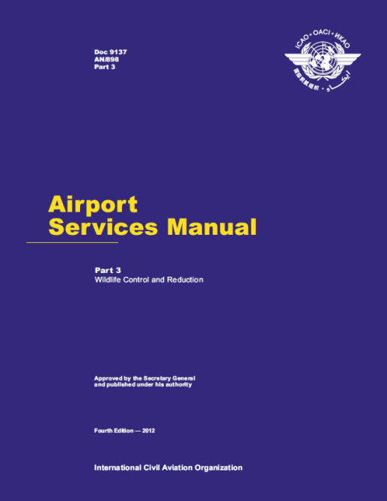
Ongoing work at ICAO (Cont’d)
Review of the Airport Services manual - Part 3 “Wildlife Hazard Management” (new title)
Objectives:
  to be consistent with the new PANS-Aerodromes;
  to reflect the evolution and current practices pertaining to wildlife hazards management;
  To include guidance on training.
Notes:
• a proposed replacement of the current title Airport Services Manual, Part 3 — Wildlife Control and
Reduction (Doc 9137), which is seen limitative, by “Wildlife Hazard Management”;
• a reorganization of the table of contents and of some of the contents themselves in order to reflect
the evolution and current practices pertaining to wildlife hazards management;
• a new chapter on training, which will complement the training-related provisions in the next edition
of the PANS-Aerodromes (Doc 9981).
Will include:
Comprehensive guidance on the fundamental elements of a Wildlife Hazard Management Programme;
Identification of stakeholders at the aerodrome and external stakeholders in the community;
Detailed guidance on safety risk assessment of wildlife strike, taking account of severity and probability;
Process for land management on aerodrome property and its vicinity;
Management of the hazardous wildlife and methods to methods to reduce the risk;
Advancement in technology; and
Operational communications procedures with airspace users.

Slide 19
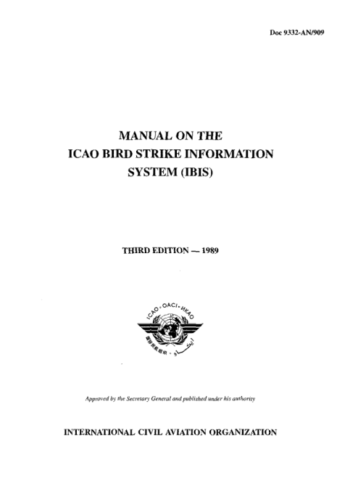
Ongoing work at ICAO (Cont’d)
Review of the Manual on the ICAO Bird/wildlife Strike information system (Doc 9332)
To be consistent with the new ECCAIRS platform
An ICAO reporting portal is under development
A dedicated email address to send report: wildlife@icao.int

Slide 20
More information will be provided:
https://www.icao.int/ibis

